Slide 1
Introduction To Code
Jaya Arpitha Kanuri Pace ID:U01935019

Slide 2
Hangman Game Using Python

Slide 3



Tools Used
Visual Studio Community
Github
React App Node Js Windows powershell

Slide 4

Things That I’ve Learned
ERROR HANDLING
GAME LOOP
DOCUMENTATION
GUESS HANDLING
RESETTING THE GAME
RENDERING
DISPLAY CALCULATION

Slide 5
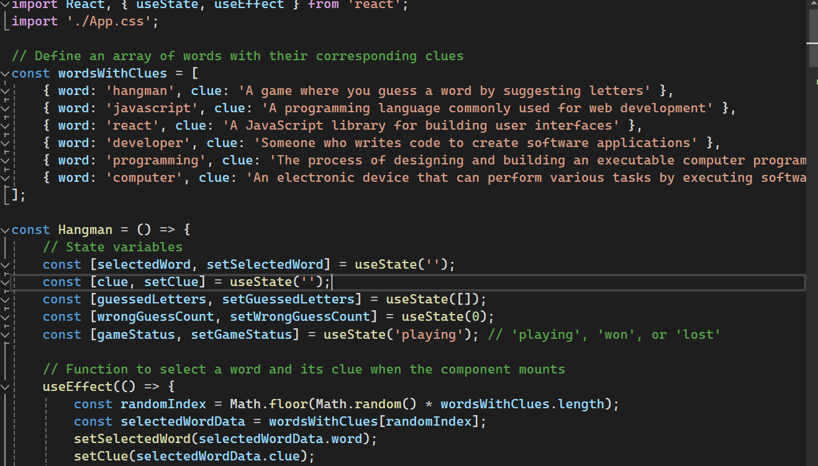
Flow of Code
Import
Arrays
Variables
Hangman
Javascript
Programming

Slide 6
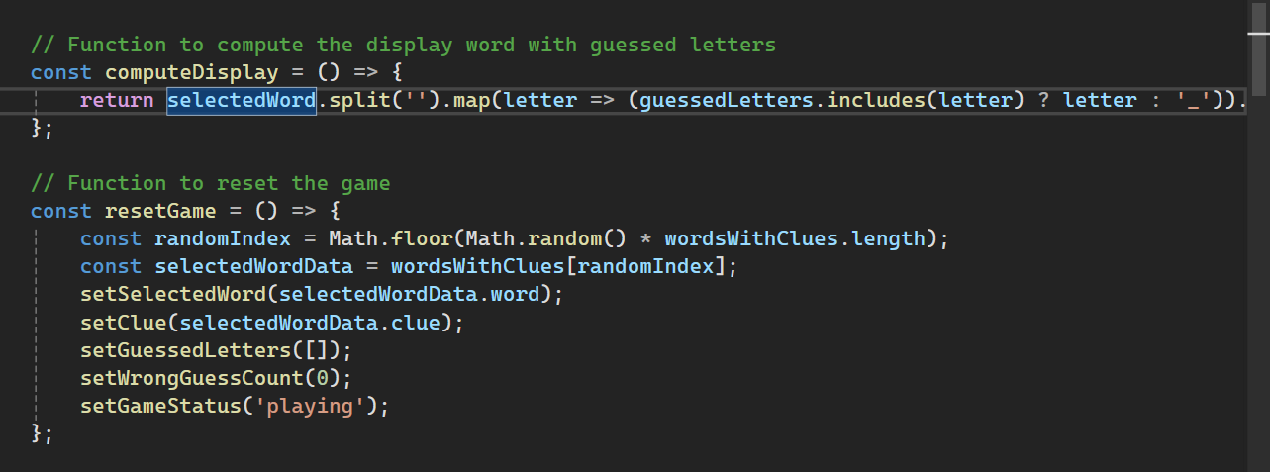
Return
Const
Selectword

Slide 7
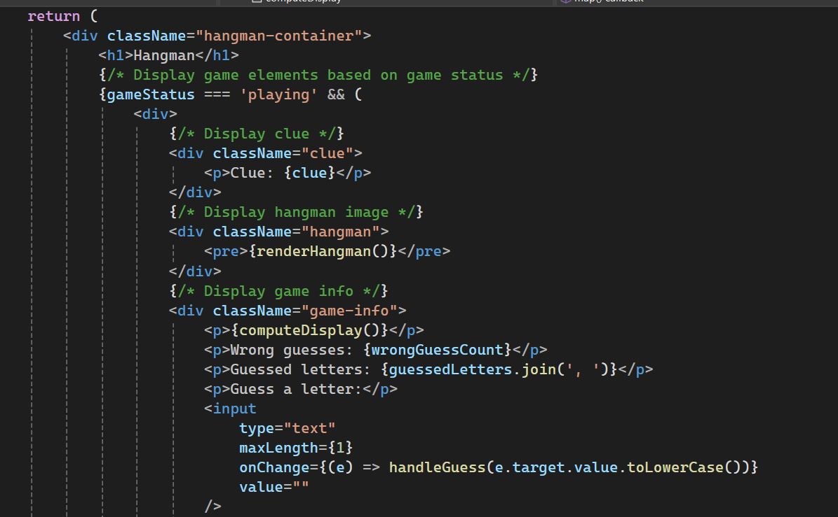
Return
Game status
Display game

Slide 8
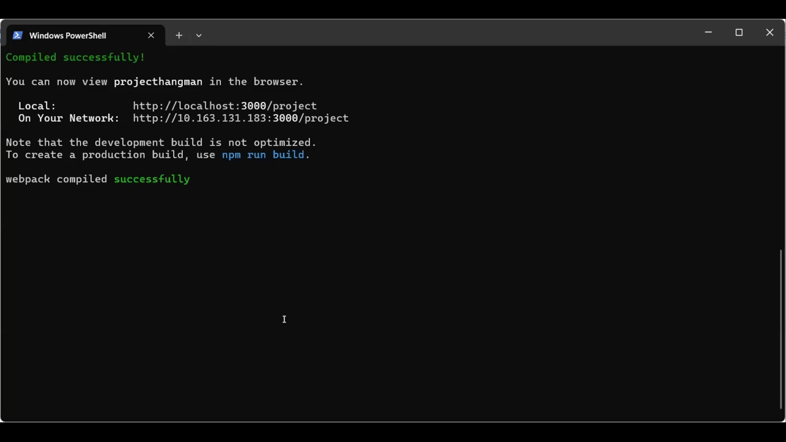
Output:

Slide 9
Github Link:
Deployed Github site : https://jayaarpitha.github.io/project Github Repository site : https://github.com/jayaarpitha/project References https://www.youtube.com/watch?v=gY5sGvq-8h8&ab_channel=ApnaCollege
https://whataboutcoding.com/host-react-js-website-live-on-the-internet-using-github/ https://www.geeksforgeeks.org/hangman-game-using-react/

